Slide 1
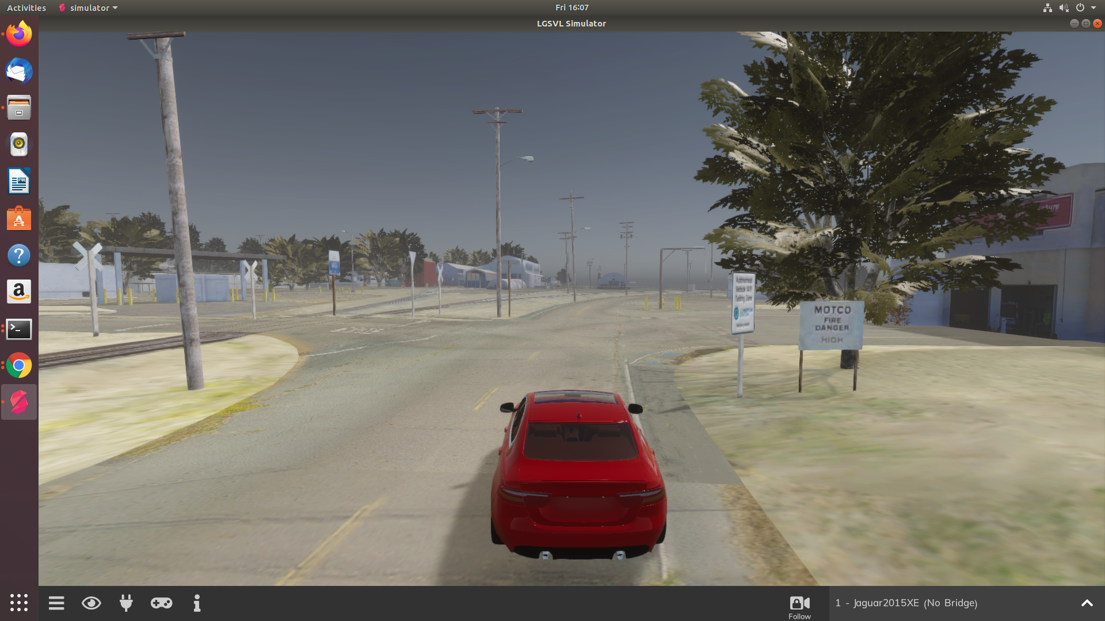
LGSVL Simulator: An Autonomous Vehicle Simulator

Slide 2
Core Concepts
The Simulator and API communicate by sending json over a websocket server running on 8181 port. The API client can be either on the same machine or any other machine on the same network.

Slide 3
API exposes the following main types:
Simulator
Agents
EGO Vehicle
NPC Vehicles
Pedestrians

Slide 4
1. Simulator
Simulator
  Main object for connecting to simulator and creating other objects.
    sim = lgsvl.Simulator(address=”localhost”,port8181)
Load method
  Load the scene map
    sim.load(scene=”BorregasAve”,seed=650387)
    seed is an Int that determines the random behaviour of the NPC vehivles and rain effects
To reset a scene to the initial state without reloading it call the “reset” method
    sim.reset()
run method
  sim.run(time_limit=5.0)
sim.run(time_limit=6,time_scale=2)
If only time_scale is specified or time_limit=0, simulation will run continuously at non-realtime speed.

Slide 5
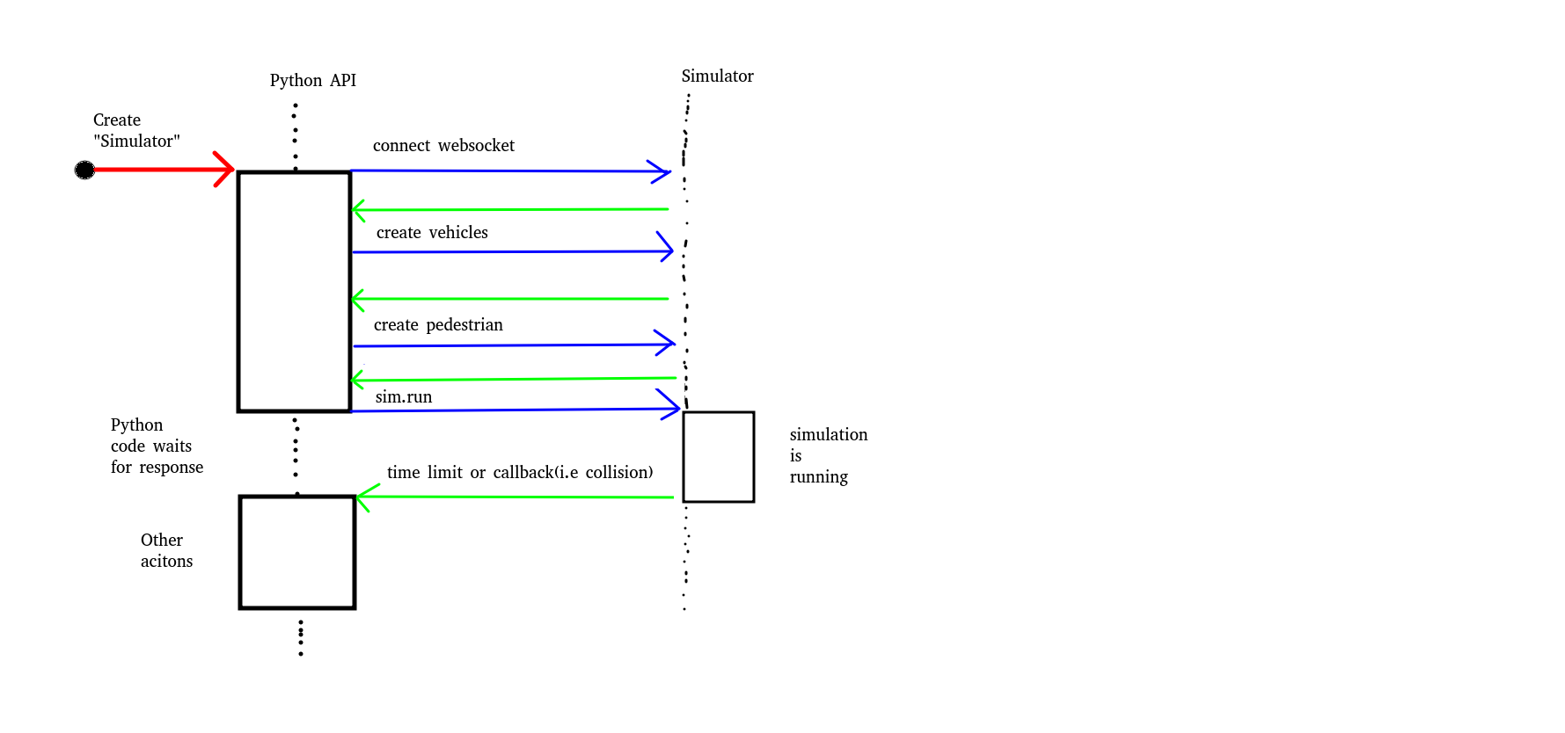

Slide 6
2. Agents(superclass of vehicles and pedestrian)
ego=sim.add_agent(name=”Lincoln2017MKZ (APOLLO 5.0)”,agent_type=lgsvl.AgentType.EGO,state=None)
We can create Agents in specific positions and orientations in the scene. For this we need to use the AgentState class
state=lgsvl.AgentState()
state : property to get or set agent state (i.e. position,velocity)
transform : property to get transform member or state (state.transform)
bounding_box : property to get bounding box in local coordinate space
on_collision : method to set a callback function to be called when the agent collides with something

Slide 7
3. EGO Vehicle (EGO vehicle with accurate physics simulation and sensors)
ego = sim.add_agent(…)
c = lgsvl.VehicleControl()
c.throttle = 0.2
ego.apply_control(c,True)
appyl_control : method to apply specified throttle,break,steering or other actions to vehicle
Pass “sticky=True” to apply these values on every simulation update iteration
get_sensors : method to return list of sensors
connect_bridge : method to connect to ROS or cyber RT bridge
bridge_connected : bool property, True if bridge is connected

Slide 8
4. NPC Vehicles (NPC vehicle with simplified physics, useful for creating many background vehicles)
change_lane : method to make the vehicle change lanes
follow : method to make vehicle follow specific way points
follow_closest_lane : method to make vehicle follow lanes
on_waypoint_reached: method to set call back function which is called for every waypoint the vehicle reaches
on_stop_line : method to set callback function which is called when vehicle reaches a stop line at intersection
on_lane_change : method to set call back function which is called when vehicle decides to change lanes

Slide 9
5. Pedestrians (pedestrian walking on sidewalks)
walk_randomly : method to make pedestrian walk randomly on the side_walk
follow : method to make pedestrian follow specific waypoints.
on_way_point_reached : method to set callback function which is called for every way point reached.
sim.add_random_agents(lgsvl.AgentType.NPC)

Slide 10
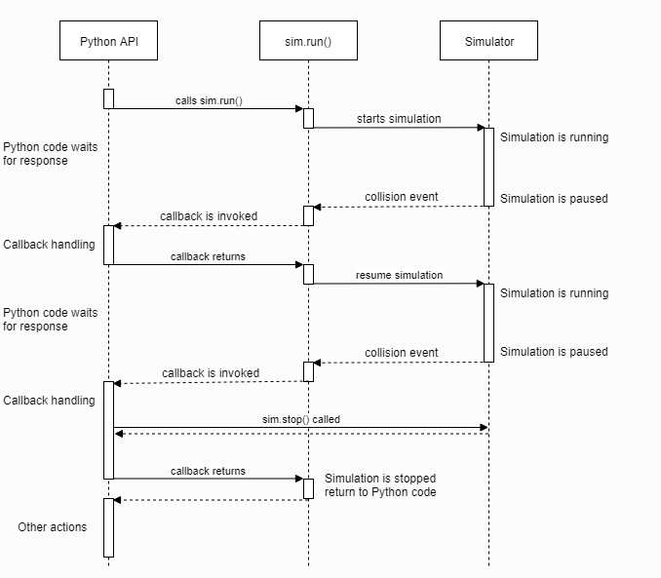
Callbacks
The Python API can invoke callbacks to inform you of specific events that occur during simulator run time.

Slide 11
ROS (Robot Operating System)
ROS is an open-source , meta-operating system for your robot.
ROS bridge protocol,
  The ROS bridge protocol is a specification for sending JSON based commands to ROS
  The specification is programming language and transport agnostic.
  The idea is that any language or transport that can send JSON can talk the ROS bridge protocol and interact with ROS

Slide 12
ROS Bridge Implementation
The rosbridge_suit package is a collection of packages that implement the rosbridge protocol and provides a websocket transport layer.
rosbridge_library : The core rosbridge package. The rosbridge_library is responsible for taking the JSON string and sending the commands to ROS and vice versa.
rosapi : Makes certain ROS actions accessible via service call that are normally reserved for ROS client libraries. This includes getting and setting parameters , getting topics list and more .
rosbridge_server : While rosbridge_library provide the JSON ↔ ROS conversion, it leaves the transport layer to other. rosbridge_server provides a websocket connection so browsers can “talk rosbridge “ . roslibjs is a JS library for the browser that can talk to ROS via rosbridge_server.

Slide 13
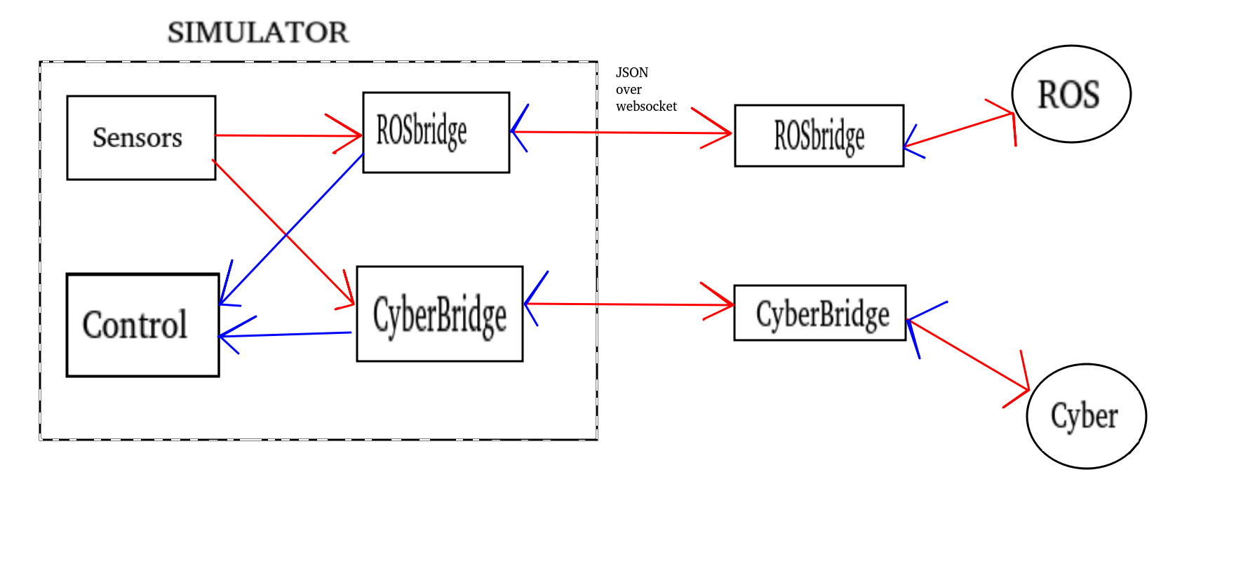

Slide 14
ROS Philosophy
Peer to peer
Distributed
Multi-lingual
Light-weight
Free & open-source

Slide 15
Computational Graph
1
Nodes
Ros Master
Parameter Server
Messages
Topics
Services
Bags
MASTER
MASTER
2
4
3

Slide 16
ROS Master
Manages the communication between nodes.
Every node registers at startup with the master.
  To start a master
    $ roscore

Slide 17
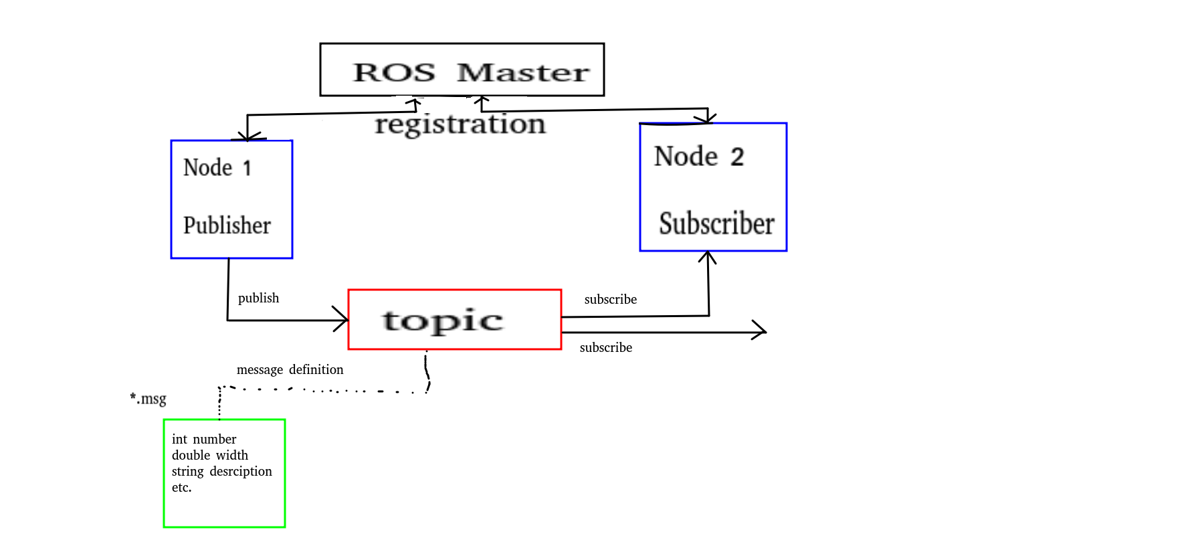

Slide 18
ROS Nodes
Single-purpose, executable program
Individually compiled,executed and managed
Organized in packages
  to run a node
    $ rosrun package_name node_name
  see active nodes
    $ rosnode list
  retrieve info
    $ rosnode info node_name

Slide 19
There are four fundamental types of ROS nodes that can be used to build a ROS applications;
Publishers
Subscribers
Services
Actions

Slide 20
1. Publishers Nodes
A ROS node that generates information is called a publisher.
A publisher sends information to nodes via topics.
Publishers are generally connected with sensors like cameras, encoders etc.

Slide 21
2. Subcriber Nodes
A ROS node that receives information is called a subscriber.
It’s subscribed to information in a topic.
It uses topic callback functions to process the received information.

Slide 22
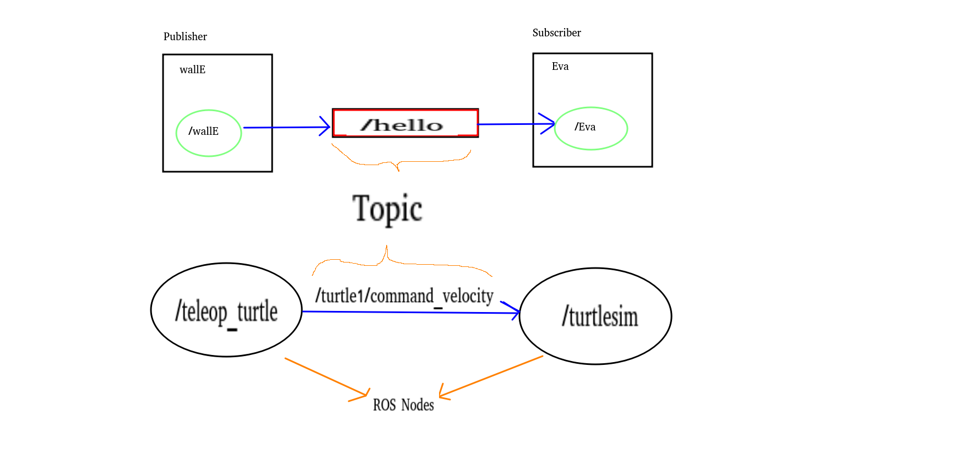

Slide 23
3. Services
They should be used for remote procedure calls that terminate quickly
  reset (affects rqt_graph )
  clear (affects history)
  spawn (create another , i.e turtle2)
    client
server

Slide 24
4. Actions
“An action is an asynchronous call to another node's functionality. You don't have to wait for the result. You can do other things pending the result.”
They should be used for any discrete behavior that moves a robot or that runs for a longer time but provides feedback during execution

Slide 25
ROS Topics
Nodes communicate over topics
Nodes can publish or subscribe to a topic
Typically, 1 publisher and n subscribers
Topic is name for a stream of messages
To see list of topics
  $ rostopic list
To Subscribe and print the contents of a topic
  $ rostopic echo /topic
To show info about topic
  $ rostopic info /topic
To see the type of topics
  $ rostopic type /topic
To publish a message to a topic
  $ rostopic pub /topic type args

Slide 26
ROS Messages
Data structure defining the type of a topic.
Compromised of a nested structure of integers,float , boolen,strings etc. and array of objects.
Defined in *.msg files.
To see list of messages
  $ rosmsg list

Slide 27
Parameter
  To obtain the value that a parameters hold
    $ rosparam get /…
  To change the value of a parameter
    $ rosparam set
Bags
  ROS bags exist for one single purpose :
    To store and retrieve messages.

Slide 28
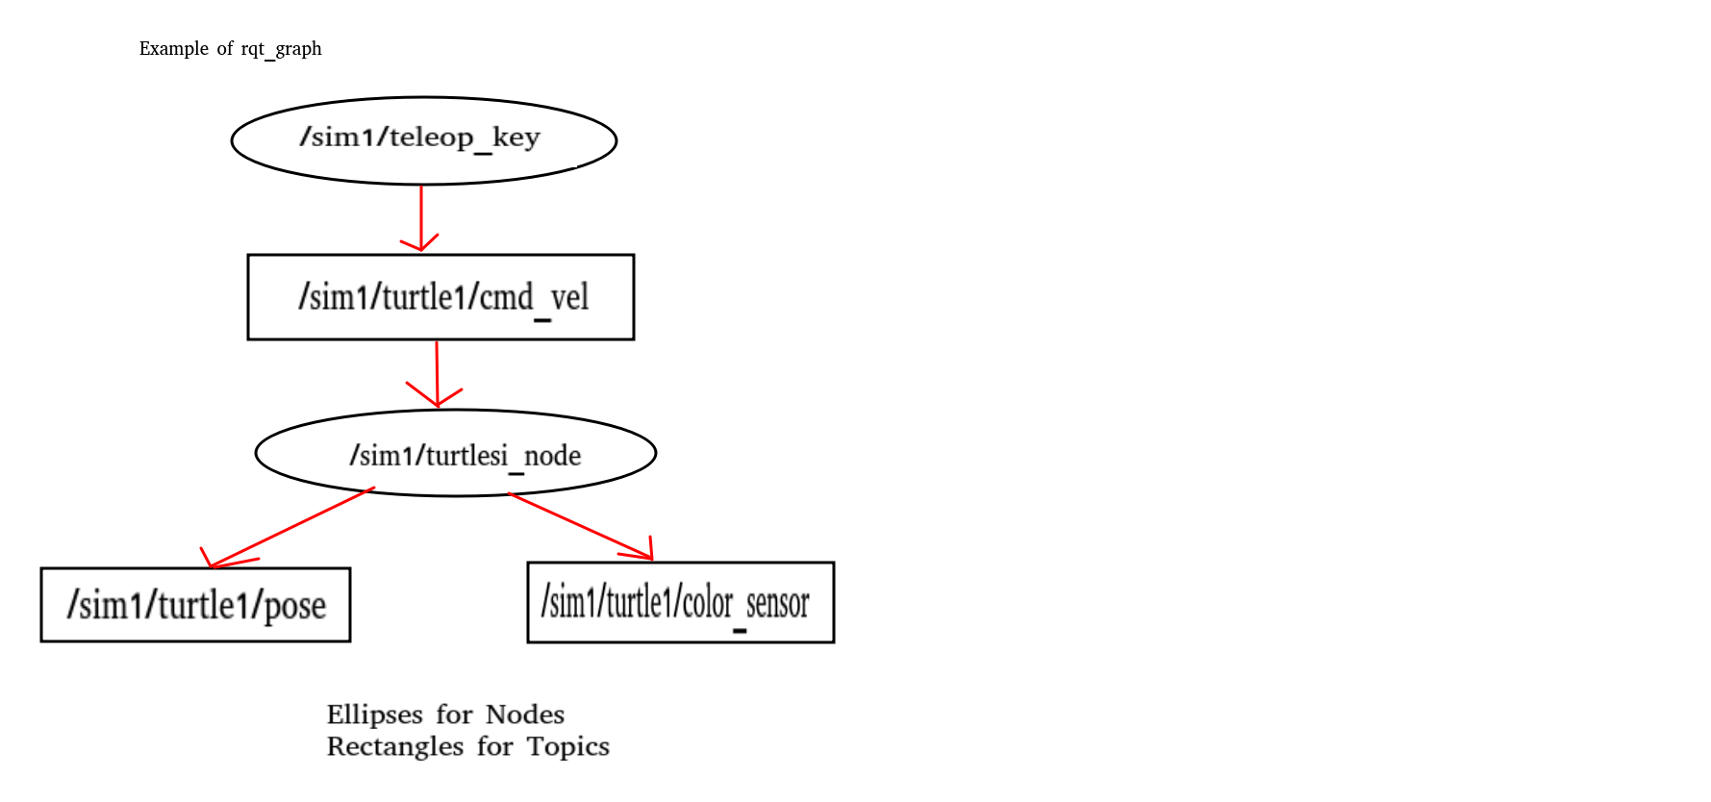
To visualise(rqt_graph)
  $ rosrun rqt_graph rqt_graph

Slide 29
ROS Package
catkin_ws
  include
  src
  scripts
  package.xml
  CMakeLists.txt

Slide 30
src → where your ROS packages will reside
We need to initialize our current directory as a workspace . To do that use the code below in source folder.
  $ catkin_init_workspace
After this, CmakeLists.txt was created.
This means that our empty workspace is ready to go through its first completion .
To compile your workspace, in your workspace
  $catkin_make
  This command that can make to start the build process.
Once the workspace was successfully built, you will find two new folders called “build” and “devil” in the root of workspace.
To create new package
  $ catkin_create_pkg robot_tutorials rospy roscpp std_msgs
  name of package is robot tutorials.
You can find CmakeLists.txt also. This contains information about how to build your ROS package.

Slide 31
To make workspace visible (in workspace),
  $ source devel/setup.bash
$ rospack find robot_tutorials
$ roscd robot_tutorials
  Before using roscd command (in workspace),
    1. catkin_make,
    2. source devel/setup.bash
$ rosls robot_tutorials
$ roscd log
  log of a ROS process stores in the hidden directory

Slide 32
package.xml
  This file defines properties about the package such as ;
    Package name,
    Authors,
    Maintainers,
    Dependencies on other catkin packages
In package.xml ,
  <build_depend> specifies which packages are needed to build your package
  <build_export_depend> is needed when your libraries needed to be built against other packages
  <exec_depend> (execution depend) specifies the packages that you need at runtime.

Slide 33
Running Rosbridge
$ source /opt/ros/melodic/setup.bash
To run rosbridge
  $ roslaunch rosbridge_server rosbridge_websocket.launch

Slide 34
To Get IMU Informations
  $ rosrun evarobot_imu_subs imu_listener
  When type this line, we get;
    Angular velocity
    Linear acceleration
    Orientation

Slide 35
To Get Odometry Informations
  $ rosrun eva_robot_subs odom_listener
  When type this line, we get;
    Linear and angular velocity
    Position
    Orinetation

Slide 36
To Get Image
Install opencv
OpenCV
OpenCV cv::Mat
ROS
CvBridge
ROS
ROS image message

Slide 37
REFERENCES
https://www.coursera.org/specializations/self-driving-cars/
https://engineersforum.com.ng/2019/03/27/7-key-challenges-we-need-to-consider-for-safe-deployment-of-autonomous-vehicles/
https://www.lgsvlsimulator.com/docs/python-api/
https://www.udemy.com/course/ros-basics-program-robots
http://docs.ros.org/
https://rsl.ethz.ch/education-students/lectures/ros.html
http://wiki.ros.org/
https://www.theconstructsim.com/ros-5-mins-034-ros-action/#:~:text=An%20action%20is%20an%20asynchronous,Action%20Server%20(Pizza%20shop).
https://www.cs.colby.edu/maxwell/courses/tutorials/maketutor/
https://cmake.org/cmake/help/v2.8.8/cmake.html
https://www.gnu.org/software/automake/manual/html_node/Standard-Configuration-Variables.html

Slide 38
https://github.com/deepaktalwardt/
https://www.deepaktalwar.me/lgsvl-micro-mobility
https://pjreddie.com/darknet/yolo/
https://en.wikipedia.org/wiki/Convolutional_neural_network#:~:text=of%20their%20layers.-,Architecture,multiplication%20or%20other%20dot%20product.
https://www.researchgate.net/figure/CNN-general-architecture_fig3_321787151

